Slide 1
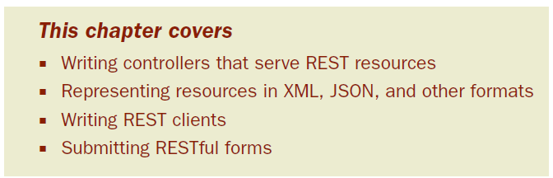
Chapter 10: Giving Spring some REST
Data is the life’s blood of many businesses. Software is often replaceable. But the data gathered over the years can never be replaced.
Notes:
-Whether it’s an email account protected with a username/password pair or a brokerage account protected with a trading PIN,

Slide 2
In recent years, Representational State Transfer (REST) has emerged as a popular information-centric alternative to traditional SOAP-based web services.
To help Spring developers take advantage of the REST architectural model, Spring 3.0 came packed with first-class support for working with REST.
The good news is that Spring’s REST support builds upon Spring MVC

Slide 3
11.1 Getting REST
Certainly, SOAP can be overkill for many applications and REST brings a simpler alternative.
The problem is that not everybody has a solid grasp of what REST really is.

Slide 4
11.1.1 The fundamentals of REST
A mistake that’s often made when approaching REST is to think of it as “web services with URLs”—to think of REST as another remote procedure call (RPC) mechanism, like SOAP, but invoked through plain HTTP URLs and without SOAP’s hefty XML namespaces.

Slide 5
On the contrary …
REST has little to do with RPC.
Whereas RPC is service-oriented and focused on actions and verbs, REST is resource-oriented, emphasizing the things and nouns that describe an application
Also, although URLs play a key role in REST, they’re only a part of the story

Slide 6
Representational
REST resources can be represented in virtually any form, including XML, JavaScript Object Notation (JSON), or even HTML
State
When working with REST, we’re more concerned with the state of a resource than with the actions we can take against resources
Transfer
REST involves transferring resource data, in some representational form, from one application to another
Notes:
Put more succinctly, REST is about transferring the state of resources—in whatever form is most appropriate—from a server to a client (or vice versa).
Given this view of REST, I try to avoid terms such as REST service, or RESTful web ser- vice, or any similar term that incorrectly gives prominence to actions. Instead, I prefer to emphasize the resource-oriented nature of REST and speak of RESTful resources.

Slide 7
11.1.2 How Spring supports REST
Spring has long had some of the ingredients needed for exposing REST resources
But with Spring 3 came several enhancements to Spring MVC providing first-class REST support
Controllers can handle requests for all HTTP methods, including the four primary REST methods: GET, PUT, DELETE, and POST.
The new @PathVariable annotation enables controllers to handle requests for parameterized URLs

Slide 8
The <form:form> JSP tag from Spring’s form-binding JSP tag library, along with the new HiddenHttpMethodFilter, make it possible to submit PUT and DELETE requests from HTML forms, even in browsers that don’t support those HTTP methods
Resources can be represented in a variety of ways using Spring’s view and view resolvers, including new view implementations for rendering model data as XML, JSON, Atom, and RSS
The representation best suited for the client can be chosen using the new ContentNegotiatingViewResolver

Slide 9
View-based rendering can be bypassed altogether using the new @ResponseBody annotation and various HttpMethodConverter implementations
Similarly, the new @RequestBody annotation, along with HttpMethodConverter implementations, can convert inbound HTTP data into Java objects passed into a controller’s handler methods
RestTemplate simplifies client-side consumption of REST resources

Slide 10
11.2 Writing resource-oriented controllers
As we saw in chapter 7, Spring MVC’s model for writing controller classes is extremely flexible
Almost any method with almost any signature can be annotated to handle a web request
But a side effect of such flexibility is that Spring MVC allows you to develop controllers that aren’t ideal in terms of RESTful resources.

Slide 11
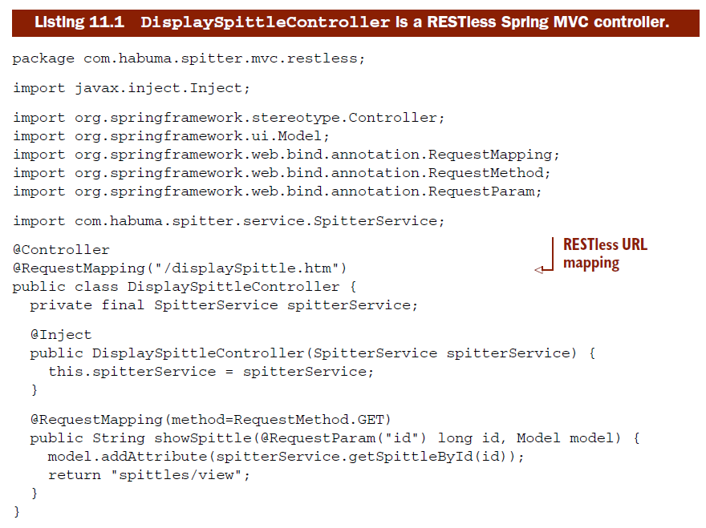
11.2.1 Dissecting a RESTless controller

Slide 12
It’s action-oriented and focused on a specific use case: displaying a Spittle object’s details in HTML form.

Slide 13
11.2.2 Handling RESTful URLs
URLs are one of the first things that most people think about when starting to work with REST
The funny thing about many URLs is that they usually don’t do what a URL is supposed to do
URL is an acronym that stands for uniform resource locator -it seems that a URL is intended to locate a resource
What’s more, all URLs are also URIs

Slide 14
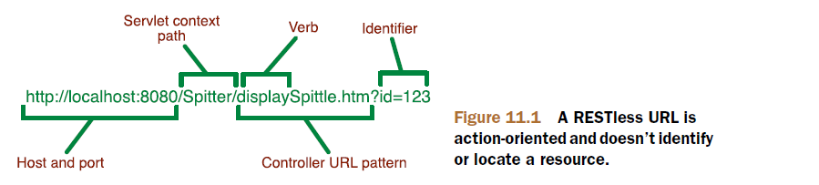
Many URLs don’t locate or identify anything—they make demands
If we’re going to write controllers that properly handle RESTful URLs, we should first get to know what a RESTful URL looks like.
Notes:
-The only part of the URL that identifies anything is the id query parameter.
-The base portion of the URL is verb-oriented. That is to say that it’s a RESTless URL.

Slide 15
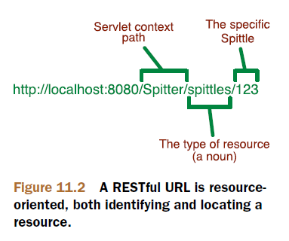
CHARACTERISTICS OF A RESTFUL URL
In contrast to their RESTless cousins, RESTful URLs fully acknowledge that HTTP is all about resources

Slide 16
Instead of using a query parameter to identify the resource, the entire base URL identifies the resource
Although query parameters are still a legitimate way to send information to the server, they’re intended to provide guidance to the server in producing the resource. They shouldn’t be used to help identify a resource
One final observation should be made about RESTful URLs: they tend to be hierarchical-from a broad concept to something more precise

Slide 17
http://localhost:8080 identifies a domain and port. Although our application won’t associate a resource with this URL, there’s no reason why it couldn’t
http://localhost:8080/Spitter identifies the application’s servlet context. This URL is more specific in that it has identified an application running on the server
http://localhost:8080/Spitter/spittles identifies a resource that represents a list of Spittle objects within the Spitter application
http://localhost:8080/Spitter/spittles/123 is the most precise URL, identifying a specific Spittle resource

Slide 18
What makes the RESTful URL interesting is that its path is parameterized
Whereas the RESTless URL took its input from query parameters, the RESTful URL’s input is part of the URL’s path
To be able to handle requests for that kind of URL, we’ll need a way to write a controller’s handler method so that it can take input from the URL’s path

Slide 19
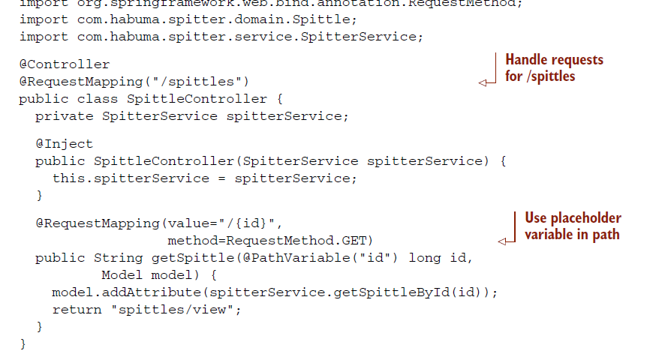
EMBEDDING PARAMETERS IN URLS
To enable parameterized URL paths, Spring 3 introduced a new @PathVariable annotation

Slide 20
With no value given to @PathVariable, the method parameter name serves as the name of the path variable
The other side of RESTful requests are the HTTP methods that will be applied to the URLs. Let’s see how HTTP methods provide the verbs in a REST request

Slide 21
11.2.3 Performing the REST verbs
As mentioned before, REST is about the transfer of resource state
Therefore, we really only need a handful of verbs to be able to act upon those resources—verbs to transfer the state of a resource
For any given resource, the most common operations will be to create a resource on the server, retrieve it from the server, update it on the server, or delete it from the server

Slide 22
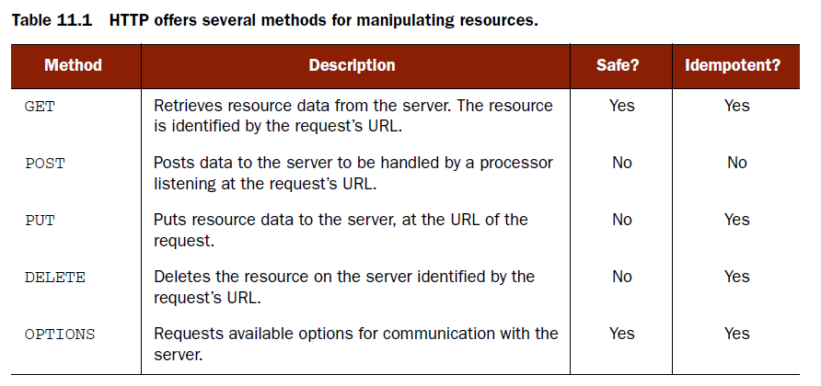
The verbs we’re interested in (post, get, put, and delete ) correspond directly to four of the methods as defined by the HTTP specification
Notes:
-By definition, all safe methods are also idempotent, but not all idempotent methods are safe.

Slide 23
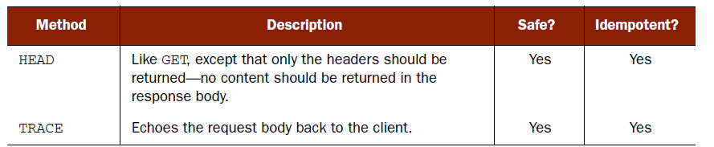
A method is considered safe if it doesn’t change the state of the resource. Idempotent methods may or may not change state, but repeated requests should have no further side effects after the first request

Slide 24
It’s important to realize that although Spring supports all of HTTP’s methods, it’s still up to you, the developer, to be sure that the implementation of those methods follows the semantics of those methods
The four HTTP methods described in table 11.1 are often mapped to CRUD (cre- ate/read/update/delete) operations.
The SpittleController’s getSpittle() method is annotated with @RequestMapping, with the method attribute set to handle GET requests
Notes:
-In other words, a GET-handling method should only return a resource—it shouldn’t update or delete a resource.

Slide 25
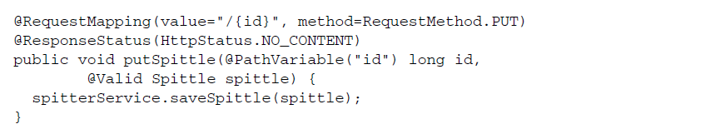
UPDATING RESOURCES WITH PUT
Whereas a GET request transfers the state of a resource from the server to the client, PUT transfers the resource state from the client to the server.
The @ResponseStatus annotation defines the HTTP status that should be set on the response to the client. In this case, HttpStatus.NO_CONTENT indicates that the response status should be set to the HTTP status code 204.
Notes:
-Again, the URL identifies a resource, not what’ll be done with it. So the URL that identifies a Spittle will be the same whether we’re GETting it or PUTting it.

Slide 26
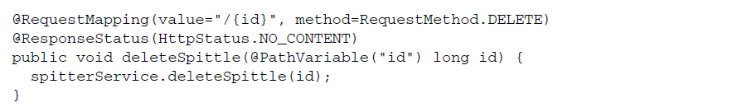
HANDLING DELETE REQUESTS
Rather than simply update a resource, we may want to get rid of it altogether.
When you don’t want a resource around anymore, that’s what the HTTP DELETE method is for.

Slide 27
CREATING RESOURCES WITH POST
Among the HTTP methods, POST is the rebel.
It’s unsafe and it is certainly not idempotent.
This nonconformist HTTP method seems to break all of the rules, but in doing so it can handle the jobs that other HTTP methods can’t.

Slide 28
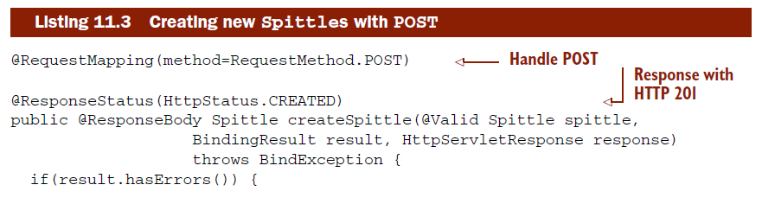
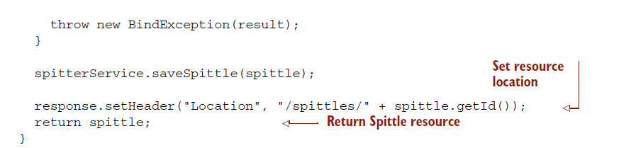
The first thing you may notice is that this method’s @RequestMapping is different from the ones we’ve seen so far.

Slide 29
whereas GET, PUT, and DELETE requests operate directly on the resource identified by their URL, POST has to operate against a URL that isn’t the same as the resource it’s creating (because that URL won’t exist until the resource is created).
So, much like the GET-handling getSpittle() method from before, this method concludes by returning the new Spittle object. This object will be transformed into some representation that the client can use.

Slide 30
11.3 Representing resources
Representation is an important facet of REST
The resource doesn’t change—only how it’s represented
It’s important to know that controllers usually don’t concern themselves with how resources will be represented
Controllers will deal with resources in terms of the Java objects that define them

Slide 31
But it’s not until after the controller has finished its works that the resource will be transformed into a form that best suits the client.
Spring provides two ways to transform a resource’s Java representation into the representation that will be shipped to the client
Negotiated view-based rendering
HTTP message converters

Slide 32
11.3.1 Negotiating resource representation
As you’ll recall from chapter 7, when a controller’s handler method finishes, a logical view name is usually returned.
DispatcherServlet then passes the view name to a view resolver
In a human-facing web application, the view chosen is almost always rendered as HTML.

Slide 33
When it comes to resolving view names into views that can produce resource representations, there’s an additional dimension to consider.
If the client wants XML, then an HTML-rendering view won’t do—even if the view name matches.
Spring’s ContentNegotiatingViewResolver is a special view resolver that takes the content type that the client wants into consideration.

Slide 34
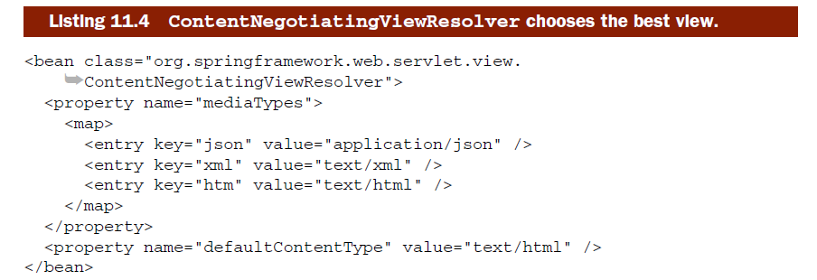
Understanding how ContentNegotiatingViewResolver works involves getting to know the content-negotiation two-step:
Determine the requested media type(s)
Find the best view for the requested media type(s)

Slide 35
DETERMINING THE REQUESTED MEDIA TYPES
On the surface, that seems like a simple job. Shouldn’t the request’s Accept header give a clear indication of what representation should be sent to the client?
Unfortunately, the Accept header can’t always be deemed reliable. If the client in question is a web browser, there’s no guarantee that what the client wants is what the browser sends in the Accept header.

Slide 36
Web browsers typically only accept human-friendly content types (such as text/html) and there’s no way (short of developer-oriented browser plug-ins) to specify a different content type.
ContentNegotiatingViewResolver will consider the Accept header and use whatever media types it asks for; but only after it first looks at the URL’s file extension.

Slide 37
If the file extension doesn’t produce any media types to work with, then the Accept header in the request will be considered. But if the request header doesn’t have an Accept header, then it’ll fall back to the media type set in the default- ContentType property.

Slide 38
INFLUENCING HOW MEDIA TYPES ARE CHOSEN
Several options that can influence the behavior of determining the requested media types:
Setting the favorPathExtension property to false will cause ContentNegotiatingViewResolver to ignore the URL’s path extension.
Adding the Java Activation Framework (JAF) to the classpath will cause ContentNegotiatingViewResolver to ask JAF for help in determining the media type for the path extension in addition to entries in the mediaTypes property.

Slide 39
If you set the favorParameter property to true and if the request has a format parameter, then the value of the format parameter will be matched against the mediaTypes property. (Additionally, the name of the parameter can be chosen by setting the parameterName property.)
Setting the ignoreAcceptHeader to true will remove the Accept from consideration.

Slide 40
FINDING A VIEW
Unlike other view resolvers, ContentNegotiatingViewResolver doesn’t directly resolve views. Instead, it delegates to other view resolvers to find a view that best suits the client.
ContentNegotiatingViewResolver asks all of its view resolvers to resolve the logical view name into a view.
With the candidate view list assembled, ContentNegotiatingViewResolver cycles through all of the requested media types, trying to find a view from among the candidate views that produces a matching content type – first match wins

Slide 41
In the end, if ContentNegotiatingViewResolver fails to find a suitable view, then it returns a null view. Or, if useNotAcceptableStatusCode is set to true, then a view with an HTTP status code of 406 (Not Acceptable) will be returned.

Slide 42
When defining machine-consumed RESTful resources, it may make more sense to develop the controller in a way that acknowledges that the data it produces will be represented as a resource consumed by another application.

Slide 43
11.3.2 Working with HTTP message converters
A typical Spring MVC controller method ends by placing one or more pieces of information into the model and designating a view to render that data to the user.
But when a controller’s job is to produce a representation of some resource, another more direct option is available that bypasses the model and view.

Slide 44
In this style of handler method, the object returned from the controller is automatically converted into a representation appropriate for the client.
Employing this new technique starts with applying the @ResponseBody annotation to a controller’s handler method.

Slide 45
RETURNING RESOURCE STATE IN THE RESPONSE BODY
Normally when a handler method returns a Java object (anything other than String), that object ends up in the model for rendering in the view.
But if that handler method is annotated with @ResponseBody, then it indicates that the HTTP message converter mechanism should take over and transform the returned object into whatever form the client needs.

Slide 46
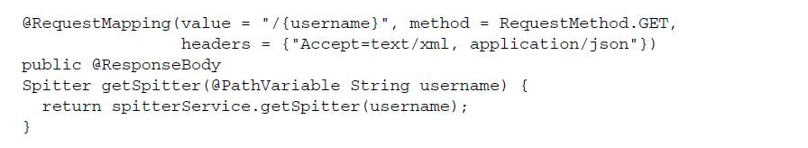
The @ResponseBody annotation tells Spring that we want to send the returned object as a resource to the client, converted into some representational form that the client can accept.
More specifically, the resource should take a form that satisfies the request’s Accept header. If the request has no Accept header, then it’s assumed that the client can accept any representation form.
Notes:
-The headers attribute indicates that this method will only handle requests whose Accept header includes text/xml or application/json. Any other kind of request, even if it’s a GET request whose URL matches the path specified, won’t be handled by this method. It’ll either be handled by some other handler method (if an appropriate one exists) or the client will be sent an HTTP 406 (Not Acceptable) response.

Slide 47
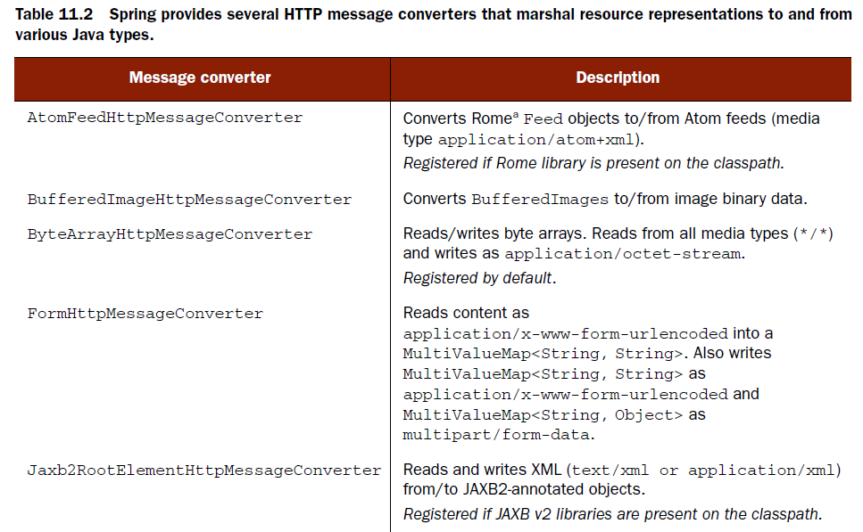
Taking an arbitrary Java object returned from a handler method and converting it into a client-pleasing representation is a job for one of Spring’s HTTP message converters.

Slide 48
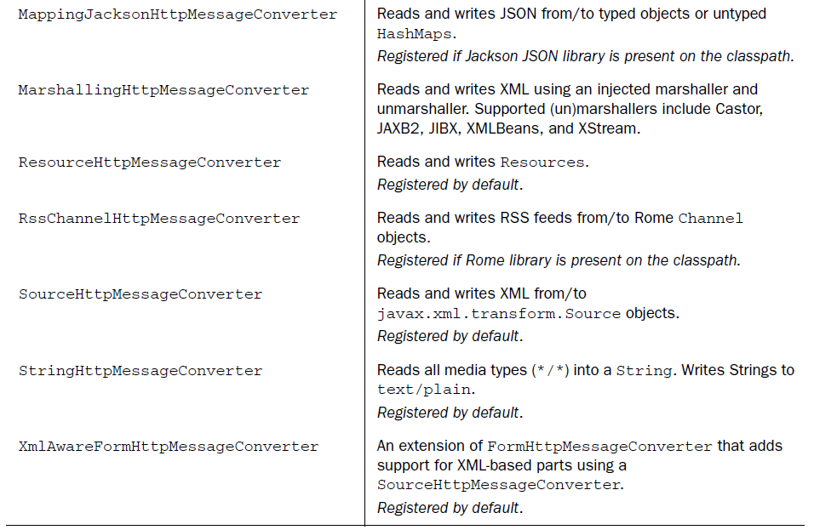

Slide 49
Note that all but three of the HTTP message converters in table 11.2 are registered by default, so no Spring configuration is required to use them.
But you may need to add additional libraries to your application’s classpath to support them. For instance, if you want to use the MappingJacksonHttpMessageConverter to convert JSON messages to and from Java objects, you’ll need to add the Jackson JSON Processor library to the classpath

Slide 50
RECEIVING RESOURCE STATE IN THE REQUEST BODY
On the other side of a RESTful conversation, a client may send us an object in the form of JSON, XML, or some other content type.
It’d be inconvenient for our controller’s handler methods to receive those objects in their raw form and convert them ourselves.
Fortunately, the @RequestBody annotation does the same thing for objects sent from the client as @ResponseBody does for objects returned to the client.

Slide 51
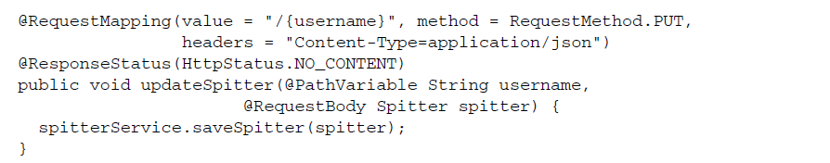
The request’s Content-Type header must be set to application/json.
The Jackson JSON library must be available on the application’s classpath.

Slide 52
11.4 Writing REST clients
Just because a resource’s data is transmitted across the web, that doesn’t mean that it’ll necessarily be rendered in a web browser.
You may even find yourself writing a web application that interacts with another web application through a RESTful API.
Writing code that interacts with a REST resource as a client can involve some tedium and boilerplate.

Slide 53
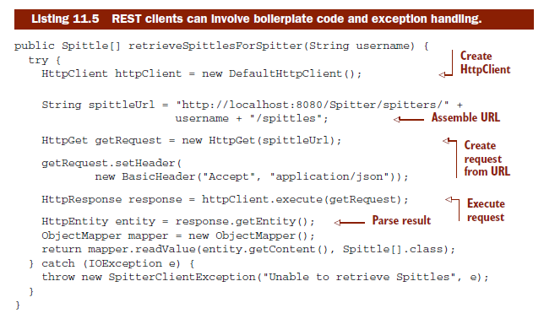
Notes:
-Looking closely at the retrieveSpittlesForSpitter() method, you’ll realize that little in that method is directly associated with this specific bit of functionality.
-If you were to write another method that consumed some other REST resource, it’d probably look a lot like this one, with only a few minor differences.
-What’s more, there are a few places along the way where an IOException could’ve been thrown. Since IOException is a checked exception, I’m forced to either catch it or throw it.

Slide 54
With so much boilerplate involved in resource consumption, you’d think it’d be wise to encapsulate the common code and parameterize the variations.
That’s precisely what Spring’s RestTemplate does.

Slide 55
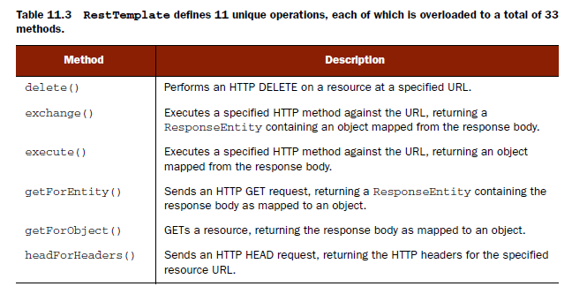
11.4.1 Exploring RestTemplate’s operations

Slide 56
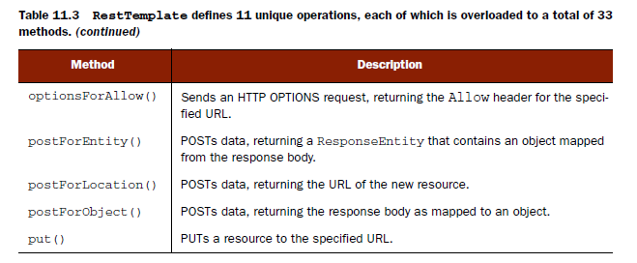

Slide 57
With the exception of TRACE, RestTemplate covers all of the HTTP verbs.
In addition, execute() and exchange() offer lower-level general-purpose methods for using any of the HTTP methods.
Each of the operations in table 11.3 is overloaded into three method forms:
One that takes a java.net.URI as the URL specification with no support for parameterized URLs
One that takes a String URL specification with URL parameters specified as a Map
One that takes a String URL specification with URL parameters specified as a variable argument list
Notes:
-Once you get to know the 11 operations provided by RestTemplate and how each of the variant forms work, you’ll be well on your way to writing resource-consuming REST clients.
-Let’s survey RestTemplate’s operations by looking at those that support the four primary HTTP methods: GET, PUT, DELETE, and POST. We’ll start with getFor- Object() and getForEntity(), the GET methods.

Slide 58
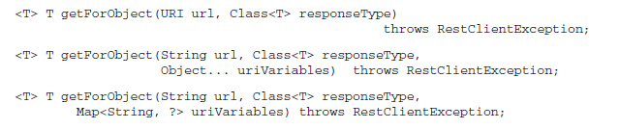
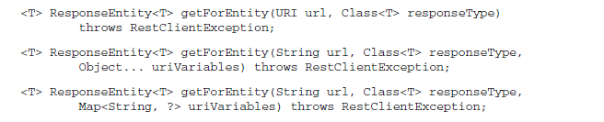
11.4.2 GETting resources
two kinds of methods for performing GET requests: getForObject() and getForEntity()
Notes:
-Except for the return type, the getForObject() methods are mirror images of the getForEntity() methods. And, in fact, they work much the same way. They both per- form a GET request, retrieving a resource given a URL. And they both map that resource to some type specified by the responseType parameter.
-The only difference is that getForObject() simply returns an object of the type requested, whereas getForEntity() returns that object along with extra information about the response.

Slide 59

RETRIEVING RESOURCES
Back in listing 11.5, retrieveSpittlesForSpitter() involved more than a dozen lines of code. Using RestTemplate, it’s now reduced to a handful of lines

Slide 60

One thing that’s absent here is any sort of JSON parsing or object mapping. Under the covers, getForObject() converts the response body into an object for us.
It does this by relying on the same set of HTTP message converters from table 11.2 that Spring MVC uses for handler methods that are annotated with @ResponseBody.

Slide 61
What’s also missing from this method is any sort of exception handling.
If anything goes wrong in getForObject(), an unchecked RestClientException will be thrown.

Slide 62
EXTRACTING RESPONSE METADATA
where getForObject() returns only the resource (converted into a Java object by an HTTP message converter), getForEntity() returns that same object carried within a ResponseEntity.
The ResponseEntity also carries extra information about the response, such as the HTTP status code and response headers.
Notes:
-For example, suppose that in addition to retrieving the resource, you want to know when that resource was last modified.

Slide 63

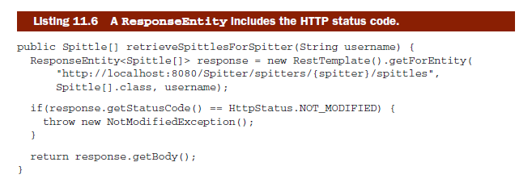
If you’re interested in the response’s HTTP status code, then you’ll want to call the getStatusCode() method.
Notes:
-Here, if the server responds with a status of 304, it indicates that the content on the server hasn’t been modified since the client previously requested it. In that event, a custom NotModifiedException is thrown to indicate that the client should check its cache for the resource data.

Slide 64
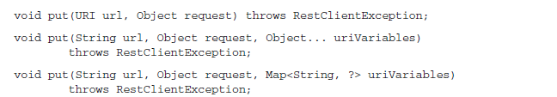


11.4.3 PUTting resources
Notes:
Here, although the method signature was simple, the implication of using a java.net.URI argument is evident. First, in order to create the URL for the Spittle object to be updated, we had to do String concatenation. Then, because it’s possible for a non-URI to be given to the constructor of URI, we’re forced to catch a URI- SyntaxException (even if we’re pretty sure that the given URI is legitimate).

Slide 65

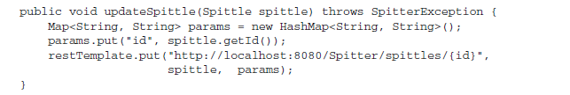
If the Jackson JSON library is in the classpath, then the MappingJacksonHttpMessageConverter will write the Spittle to the request as application/json.
Optionally, if the Spittle class were annotated for JAXB serializa-tion and if a JAXB library were on the classpath, then the Spittle would be sent as application/xml and be written to the request body in XML format.
Notes:
In all versions of put(), the second argument is the Java object that represents the resource being PUT to the server at the given URI. In this case, it’s a Spittle object. RestTemplate will use one of the message converters from table 11.2 to convert the Spittle into a representation to send to the server in the request body.

Slide 66
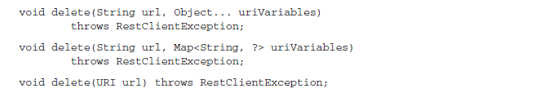
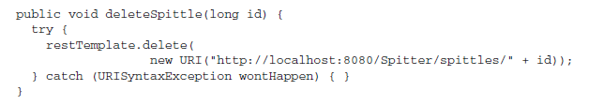

11.4.4 DELETE-ing resources

Slide 67
11.4.5 POSTing resource data
The postForObject() and postForEntity() methods work with POST requests in a way that’s similar to how getForObject() and getForEntity() work for sending GET requests. The other method, getForLocation(), is unique for POST requests.

Slide 68
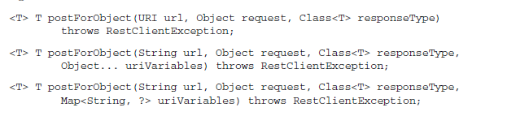
RECEIVING OBJECT RESPONSES FROM POST REQUESTS
Let’s say that you’re using RestTemplate to POST a new Spitter object to the Spitter application’s REST API. Since it’s a brand-new Spitter, the server doesn’t know about it (yet).
Notes:
-Therefore, it’s not officially a REST resource yet and doesn’t have a URL. Also, the client won’t know the ID of the Spitter until it’s created on the server

Slide 69

When POSTing new Spitter resources to the Spitter REST API, they should be posted to http://localhost:8080/Spitter/spitters, where a POST-handling controller handler method is waiting to save the object.

Slide 70
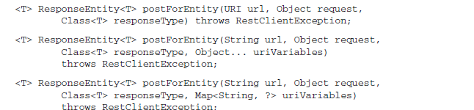
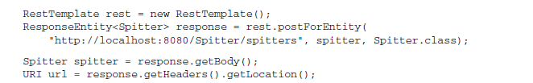
As with the getForObject() methods, we may want to examine some of the meta- data that comes back with the request.
Notes:
-From that object you can call getBody() to get the resource object (a Spitter in this case). And the getHeaders() method gives you an HttpHeaders from which you can access the various HTTP headers returned in the response.

Slide 71
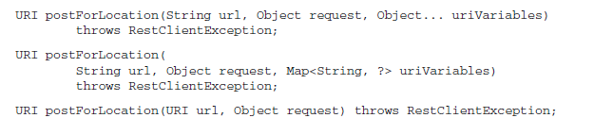
RECEIVING A RESOURCE LOCATION AFTER A POST REQUEST
Often you don’t need the resource to be sent back to you (after all, you sent it to the server in the first place). If the value of the Location header is all you really need to know, then it’s even easier to use RestTemplate’s postForLocation() method.

Slide 72
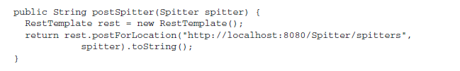

Slide 73
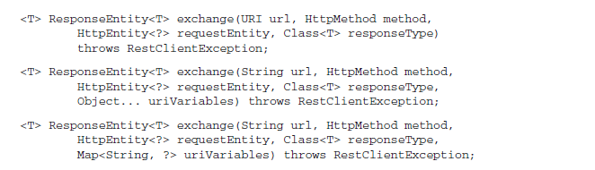
11.4.6 Exchanging resources
Being able to read headers from the response is useful. But what if we want to set headers on the request sent to the server? That’s what RestTemplate’s exchange() methods are good for.

Slide 74
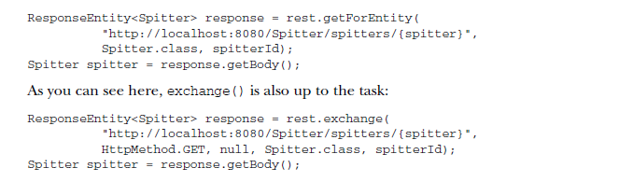
The exchange() method also takes an HttpMethod parameter to indicate the HTTP verb that should be used. Depending on the value given to this parameter, the exchange() method can perform the same jobs as any of the other RestTemplate methods.
Notes:
-By passing in HttpMethod.GET as the HTTP verb, we’re asking exchange() to send a GET request. The third argument is for sending a resource on the request, but since this is a GET request, it can be null.
-The next argument indicates that we want the response converted into a Spitter object. And the final argument is the value to place into the {spitter} placeholder in the specified URL template.

Slide 75
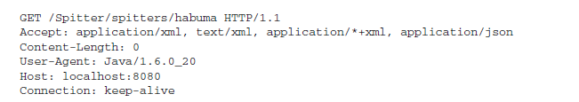

Without specifying the headers, exchange() will send the GET request for a Spitter with the following headers:
Setting request headers is a simple matter of constructing the HttpEntity sent to exchange() with a MultiValueMap loaded with the desired headers:

Slide 76



Slide 77
11.5 Submitting RESTful forms
HTML 4 only officially supports GET and POST in forms, leaving PUT, DELETE, and all other HTTP methods in the cold.
Even though HTML 5 and newer browsers will support all of the HTTP methods, you probably can’t count on the users of your application to be using a modern browser.

Slide 78
Common trick: masquerade a PUT or DELETE request in the form of a POST request
Spring supports POST masquerading through two features:
Request transformation with HiddenHttpMethodFilter
Hidden field rendering with the <sf:form> JSP tag

Slide 79
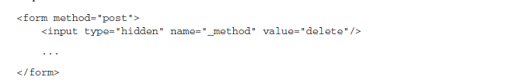

11.5.1 Rendering hidden method fields in JSP

Slide 80
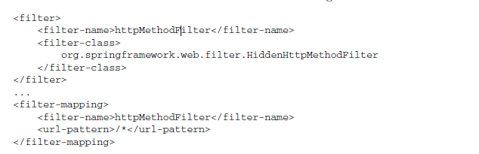
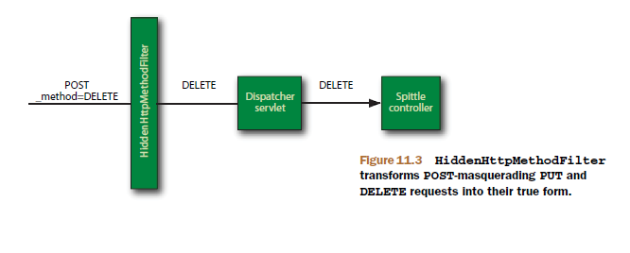
11.5.2 Unmasking the real request

Slide 81
Exercise 10-1
Write a REST Client by implementing SpitterClient

Slide 82
-End of Chapter 10-

